Slide 1
INTRODUCTION TO SOFTWARE ENGINEERING
LECTURE - 1
SEPTEMBER, 2018

Slide 2
CORE TOPICS TO BE COVERED IN CSD201
Software Development Life Cycle Phases
  Software Project Planning
  Software Requirements Engineering
  Software Design
  Software Development
  Software Testing
  Software Maintenance
Introduction to Software Engineering

Slide 3
SOME GENERAL DEFINITIONS
What is software?
“Computer software or simply software is any set of instructions that directs a computer to perform specific operations.” [wikipedia].
“Software is considered to be a collection of executable programming code, associated libraries and documentations.”
Introduction to Software Engineering

Slide 4
SOME GENERAL DEFINITIONS
What is engineering?
“developing products, using well-defined, scientific principles and methods. ”
“Engineering is the application of mathematics, empirical evidence and scientific, economic, social, and practical knowledge in order to invent, innovate, design, build, maintain, research, and improve structures, machines, tools, systems, components, materials, and processes.” [wikipedia]
What is software engineering?
“Software engineering is the study and an application of engineering to the design, development and maintenance of software” [wikipedia]
Introduction to Software Engineering

Slide 5
SOME CONCRETE DEFINITIONS
Software
“instructions (computer programs) that when executed provide desired function and performance, (2) data structures that enable the programs to adequately manipulate information, and (3) documents that describe the operation and use of the programs.” [Pressman]
Software Engineering
“[Software engineering is] the establishment and use of sound engineering principles in order to obtain economically software that is reliable and works efﬁciently on real machines.” [Pressman]
ntroduction to Software Engineering

Slide 6
SOME CONCRETE DEFINITIONS
Software Engineering
“The application of a systematic, disciplined, quantifiable approach to the development, operation and maintenance of software” [IEEE]
ntroduction to Software Engineering

Slide 7
SOFTWARE APPLICATION DOMAINS
System software
Application software
Engineering/scientific software
Embedded software
Product-line software
Web Applications
Mobile Applications
Artificial Intelligence Software
Introduction to Software Engineering

Slide 8
SOFTWARE IS CHANGING
Web Apps
  Web based systems and applications
Mobile Applications
Cloud Computing
  Software as a Service (SaaS)
  Platform as a Service (PaaS)
  Infrastructure as a Service (IaaS)
Product Line Software
ntroduction to Software Engineering

Slide 9
WHY SOFTWARE ENGINEERING IS A TRICKY DISCIPLINE?
The ultimate goal is customer satisfaction
  However, in general, the customers do not know what they really want
Uncertainty exist at every step in each phase of the development life cycle
Requirements keep on changing
Software development is much more than programming
Software has to be maintained after going live
Introduction to Software Engineering

Slide 10
WHY SOFTWARE ENGINEERING IS A TRICKY DISCIPLINE?
Up-front detailed estimation and design are complicated yet unnecessary
Have to pay the technical debt
Social activity
…..
Introduction to Software Engineering

Slide 11
SOFTWARE ENGINEERING FAILURES CASES
Faulty Soviet warning system nearly causes WWIII (1983)
  The software system malfunctioned and issued a false alarm
  Lives of millions of human beings could have been at risk
The Explosion of the Ariane 5 (1996)
  “the self-destruction was triggered by software trying to stuff "a 64-bit number into a 16-bit space”
  Cost of project failure: 8 billion US dollar
Blackout for 50 million across north America (2003)
  The reason was a race condition bug in the code
Introduction to Software Engineering

Slide 12
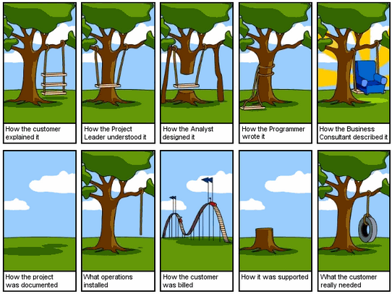
THE DILEMMA
Introduction to Software Engineering

Slide 13
WHY DOES SOFTWARE FAILURES OCCUR?
Lack of management
Lack of clear specifications
Misunderstanding of specifications
Infeasible specification
Coding and transcription errors
Equipment failures
Operating system, compiler and library failures
Changes in external systems
Changes in internal subsystems
Unintended consequences of other changes
Careless or malicious human intervention
Introduction to Software Engineering

Slide 14
HOW DOES SOFTWARE FAILURES OCCUR?
Incorrect code
Missing code
Extra code
Incorrect references to external processes
Code that does not meet time constraints
Code that does not meet space constraints
Human interfaces that dont match people's training or preferences
Introduction to Software Engineering

Slide 15
HOW TO IMPROVE?
<Class participation>
<Oration by instructor>
Introduction to Software Engineering

Slide 16

Q&A
Introduction to Software Engineering

